Slide 1
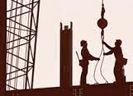
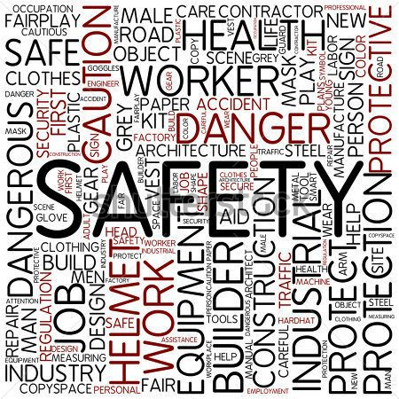
Awareness Training, Ericsson
Occupational Health & Safety

Slide 2

Health & Safety Agenda
Safety Rules & Guidelines
Personal Protective Equipment
Working at Height Safety
BMAS OHS Audit for MS Field Services
Videos: Incident & Accident Reporting
OHS part in FEAT
Permit To Work at height (PTW)
Site Safety Inspections (SSI)
4 Wheeler Pre-drive audit
2 Wheeler Pre-drive audit
DO & DON’T
Climbing At Height Safety
Driving & Vehicle Safety
Electrical Safety

Slide 3
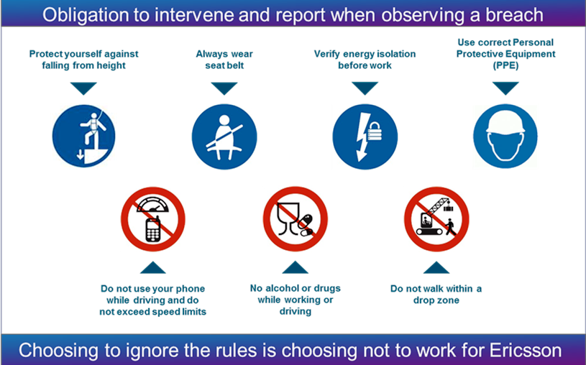
Zero Tolerance Safety Rules

Slide 4
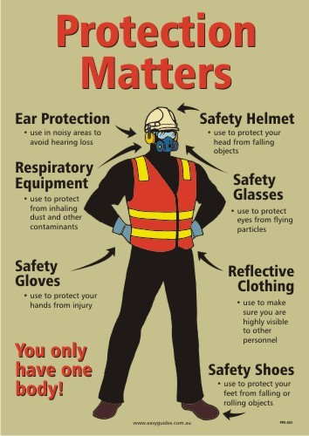
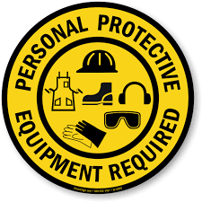
Personal Protective Equipment (PPE)
Use PPE without fail .. not optional !
Vehicular Driving
Working on height
Climbing a Telecom Tower
Working underneath an Installation
Mechanical/Electrical Repair works
Working on Fiber Route at Road-side…
STANDARD
&
APPROVED

Slide 5
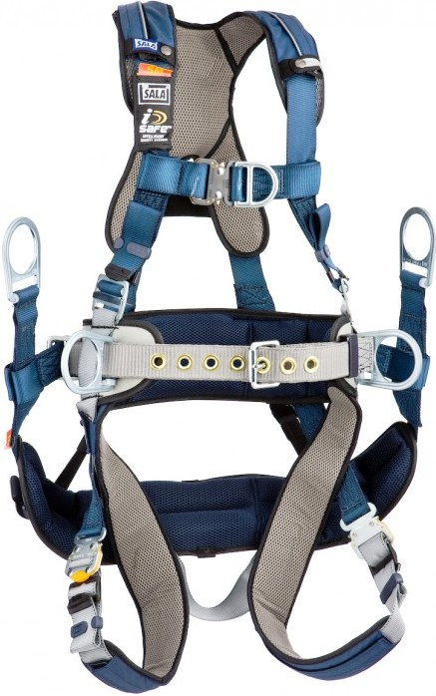
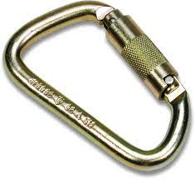
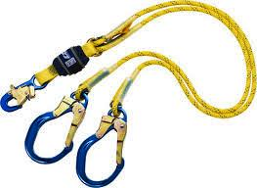
Personal Protective Equipment (PPE)
Safety Belts & Harness for Fall Protection
Only Class-3 type
Lanyards
Fall protection anchor point
Navigation, while 100% tied-off
Carabiners - Reverse connect & Lock

Slide 6
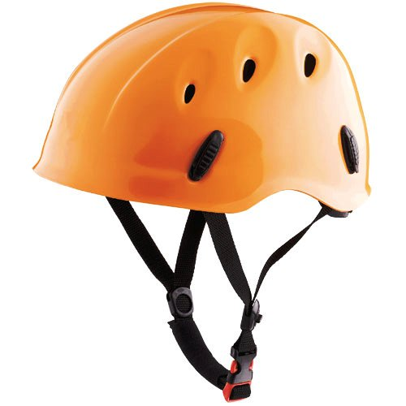
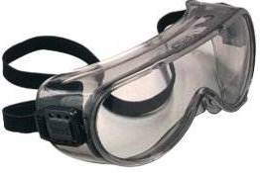
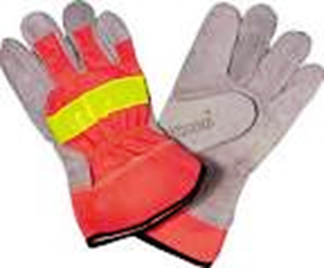
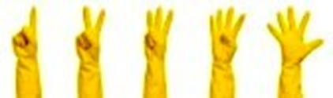
Personal Protective Equipment (PPE)
Hard Hats for Head protection
Equipped with Chin strap and cradle harness
Made of HDPE, ABS or Polycarbonate
Eye Goggles for Eye protection
Equipped with Head band/strap
Dustproof, clear and scratch free
Hand Gloves for Injury protection
Suitable working gloves for right grip
Hazard Type of Glove
Light Duty Cotton/ Leather
Medium Duty Leather Palm
Heavy Duty Cut resisted material
Hot Duty Insulating Gloves

Slide 7
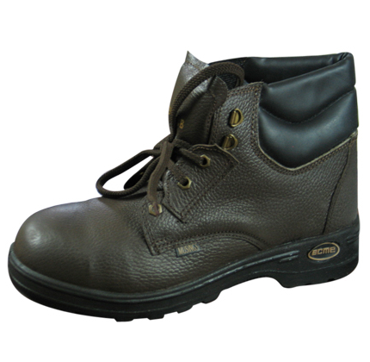
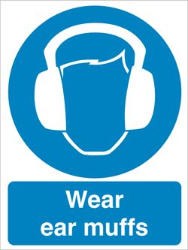
Personal Protective Equipment (PPE)
Shoes for Feet protection
Leather Boots with non-conductive soles
Steel-toe protection, sturdy fit
Extra grip for slip protection
Approved quality Shoes
Ear Plugs for Ear protection
Use Ear Plugs/Sound mufflers for Noisy areas
Noise Zone Day Time Night Time
(06.00-21.00 Hrs.) (21.00-06.00 Hrs.)
Industrial area 75dB 70db
Commercial area 65db 55db
Residential area 55db 45db
Silence Zone * 50db 40db
* Up-to 100 meters around Hospitals, Educational and Court premises.

Slide 8
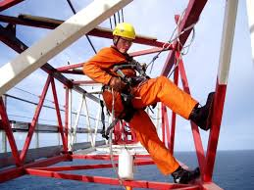
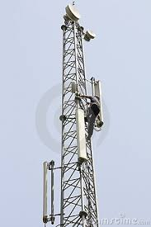
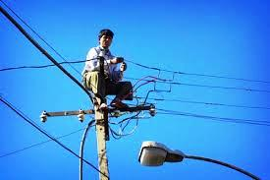
Working at Height Safety
Safe Climbing - Prerequisites
Trained & Approved Climbers
Sound medical fitness of the Climber
Safe Climbing - Requirements
Inspected and approved PPE
Full Body Harness, Anti-slippery shoes
Adequate protective clothing, Hard Helmet
Approved & Inspected lifting devices & tools
Tower must be earthed properly and
structurally safe- ensure before climbing

Slide 9
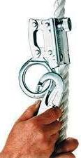
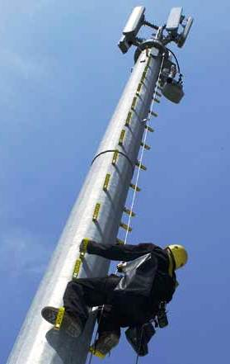
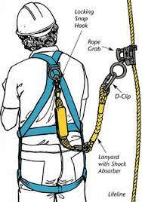
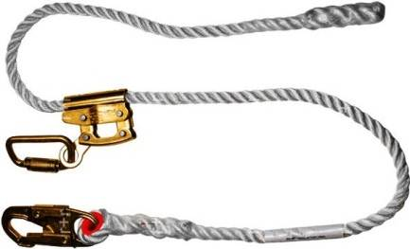
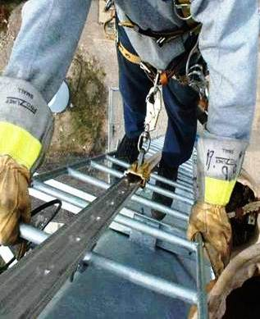
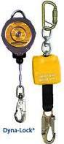
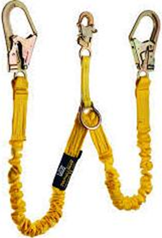
Safety on Telescopic/Monopoles
Vertical Life-Line (Rope /Steel)
Fall Arrester - Rope/Cable Grabs
Full Body Harness
Positioning Lanyards
Self-Retracting
Shock- absorbing

Slide 10
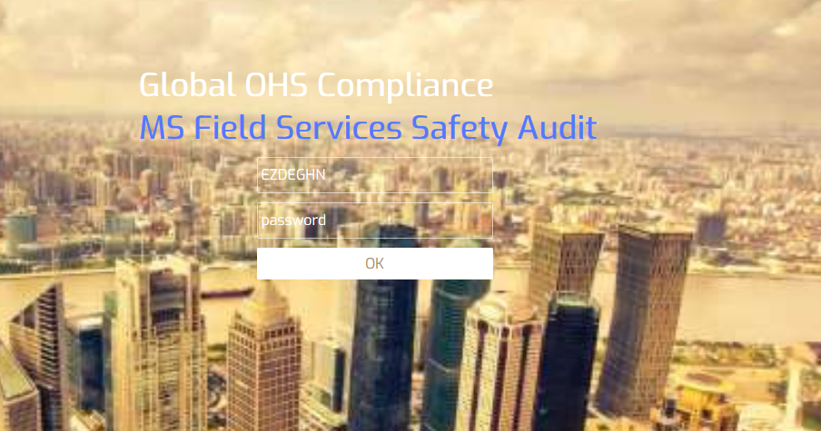
BMAS OHS Audit for MS Field Services
Each person providing general field services is to be audited at least twice per year.
Audits are to be performed by line managers, or team leads.
Audits should take place while observing the activity of the field resource, performing regular job tasks.
Audit results circulation per month.
Url: http://125.22.98.132:801/
Process:
ZTM and its equivalent shall audit FME and its equivalent in their circle.
O&M Head and its equivalent shall audit ZTM and its equivalent in their circle.
Circle Head shall audit O&M Head and its equivalent in their circle.

Slide 11
Video links for full explanations-
Incident reporting tool: GIRT
Incident handling process https://play.ericsson.net/media/t/0_1brh9zfk
OHS -ASP Training https://www.ericsson.com/en/about-us/sustainability-and-corporate-responsibility/responsible-business/responsible-sourcing/ohs-online-training
Supplier’s OHS Requirements https://www.ericsson.com/en/about-us/sustainability-and-corporate-responsibility/responsible-business/responsible-sourcing/supplier-ohs-requirements/english
Zero Tolerance Safety Rules https://www.ericsson.com/en/about-us/sustainability-and-corporate-responsibility/responsible-business/health-and-safety

Slide 12
PERMIT to Work @ Height
The following procedures shall apply:
Permit to Work at height check list implemented in FEAT tool Apps.
All FMEs, ZTMs, O&M Heads and CHs are defined in FEAT.
Line manager must ensure that adequate PPE is available on site for the assigned work and it is inspected prior to use. Including for monopole sites.
FME/DT Engineer will raise PTW workorder only if all the points in Section 2 are confirmed. (refer Mandatory checks for PTW approvals in next slide.
FME/DT Engineer shall fill all mandatory PTW checklist in FEAT before starting any work at height activity and submit by putting his signature as an authentication for next level approval by ZTM/ NPI Lead.
ZTM/ NPI Lead verify all mandatory PTW checklist which are submitted by FME. (e.g Pics of Rigger with mandatory PPEs/ Work@Height Certificate and Medical fitness Certificate of Rigger etc.)
ZTM/ NPI Lead approving or rejecting the request in FEAT as per the mandatory checks by putting his remarks & signature as an authentication. (refer Mandatory checks for PTW approvals in next slide).
FME/DT Engineer shall allow Rigger to climb the height/tower and start working only after receiving PTW approval by ZTM/ NPI Lead in FEAT.
FME/DT Engineer shall ensure that Rigger hooks should be anchored always starting from stairs. There should be one hook always anchored.
FME/DT Engineer should always vigilant and keep monitoring each activity at site performing by Rigger.
No deviation is allowed in PTW process.
Zero Tolerance to be followed for PTW checks.

Slide 13
Mandatory checks for PTW approvals
PTW approval will be done only if following points are 100% confirmed. ZTMs/NPI Leads should reject the PTW and ask for new request if any data is missing/not clear.
Before allowing Rigger to start the work, ensure present physical condition of Rigger (no feeling sick, fatigues, sleepiness, tiredness etc).
Always give verbal messages to Rigger:
Life is important
Safety is your responsibility
Always anchor yourself with tower
Workorder No. & Site ID
Competent Rigger: FARM and Medical certificates of Rigger must be handy with resource.
Adequate PPEs wore by Rigger (Double Lanyard Full Body Safety Harness, Shoes, Gloves, Helmet etc)
Picture of Rigger with PPEs
Picture of Drop Zone
No tower/height climbing during Bad weather (rainy/windy), slippery, Honey-bee & Eagle affected sites and after sunset.
Area cordoned off / drop Zone marked
Emergency contact numbers available
Is Lightning storms in the vicinity
Poor visibility -Is there light visibility Okay
A supervisor available to monitor the work at height

Slide 14
Site Safety Inspections (SSI)
Purpose of OHS Site Safety Inspection: To improve safety in performing high risk activities [ i.e. Antenna Rectification/ Installation of Antenna / MW Activity / Optimizations] and to ensure adherence controls to its standards
Process:
ZTM performing SSI
audits of 2 sites
Domain Leads verifying those
sample site
Final Validation by
Circle head
Refinement of
observation during
next visit or PM
Critical OHS Parameters for SSI audit:-
1. Rigger trained (CBTHR/FARM certified)?
2. Mandatory PPE ?
3. Permits to Work @ Height?
4. Safe zone setup properly?
5. Sufficient barriers and signage?
6. Electrical work lock out procedures in place?
7. NO Smoking/ Alcohol regulations?
8. Emergency contact numbers?
9. Control measures on site?
10. ZTSR Awareness?

Slide 15
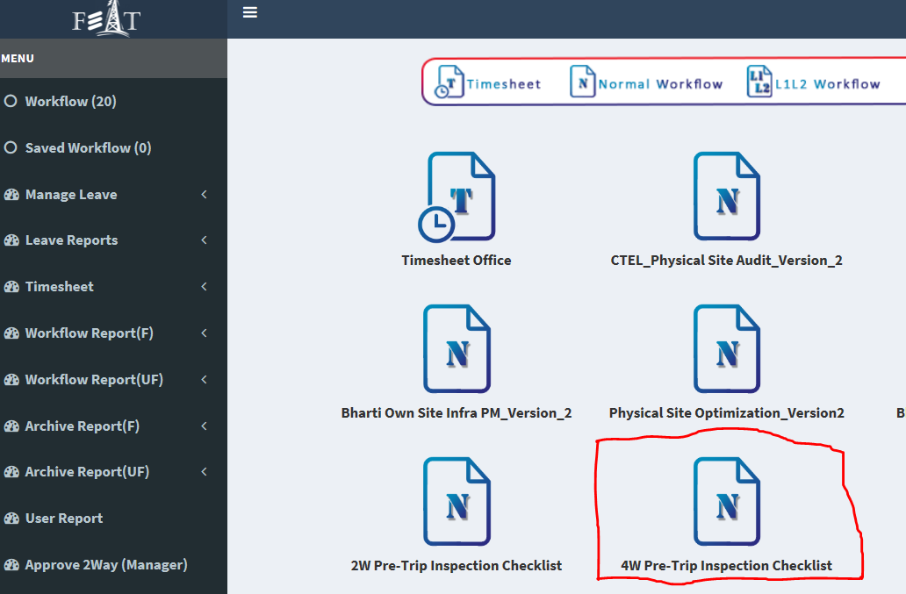
4 Wheeler Pre-trip audit
Purpose: For safety measure and safety awareness on road , user need to submit 4 wheeler pre-trip inspection checklist in FEAR before starting the ride.
Process:
All resources who are moving on 4 wheelers for any field operational activity must submit “4 -wheeler” compliance check sheet in FEAT

Slide 16
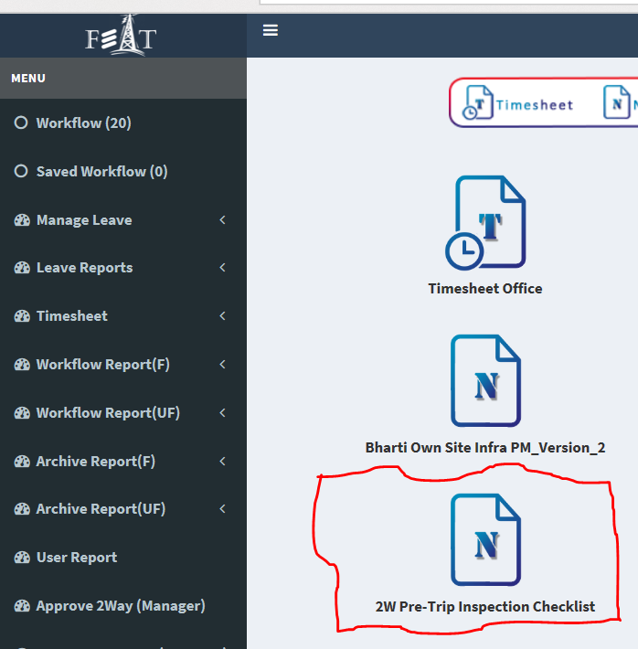
2 Wheeler Pre-trip audit
Purpose: For safety measure and safety awareness on road , user need to submit 2 wheeler pre-trip inspection checklist in FEAR before starting the ride.
Process:
All resources who are moving on 2 wheelers for any field operational activity must submit “2 -wheeler” compliance check sheet in FEAT

Slide 17
Climbing At Height Safety
Do’s
Always use standard Personal Protective Equipment.
- PPE for riggers: Safety Kit (Full body safety harness, Lanyard, Fall Arrestor), Safety helmet, Safety shoes Safety gloves, Safety glass & Reflecting jacket etc.
- PPE for non-climbing FMEs: Safety helmet, Safety shoes & Reflecting jacket.
Free climbing is not allowed at any time. It is mandatory to use full body safety harness & other means
of fall protection while working above 2 meters of height.
3Ps contact all time should be maintained without fail while climbing at height.
Adherence of Permit to Work@Height process.
Allow only Trained/Certified and Medically fit Climbers.
Inspect Tower and around, look for tower earthing before activity.
Get-off the tower immediately, as soon as you hear storms (thunder, lightning).
Always have an emergency plan, know your location & directions.
Discourage visitors and on-lookers near the tower.
Report any Incident (Near miss, Minor, Major) immediately in GIRT.
Ensure Zero Tolerance Safety Rules to be followed.
All resource must complete OHS mandatory trainings available on ITM/External ITM:Occupation Health & Safety Induction, Incident Handling, Radio Frequency Exposure (Part 2) & Safe Driving Awareness.
Don'ts
Never climb a Tower without adequate PPEs.
Never climb/work on a tower when tired or feeling sick.
Never throw things off the tower- it has fatal consequences.
Do not climb tower in bad weather (rainy/windy) and after sunset.

Slide 18
Driving & Vehicle Safety
Do’s
Before starting first trip every morning FME/ZTM upload Pre-trip inspection checklist in
FEAT tool.
Must check Permanent valid driving licenses, vehicle and rider insurance, RC, PUC and fully serviced vehicle.
2-wheeler compliance: always use Full Face ISI marked helmet with chin strap, Reflecting Jackets, Safety Shoes and Driving gloves.
4-wheller compliance: all seats belt in good condition, RC & Insurance copy verified, Vehicle must be regularly maintained and roadworthy condition, driver must be trained in 4W defensive driving trainings.
Report any Incident (Near miss, Minor, Major) immediately in GIRT.
Always have an emergency plan, know your location & directions.
Ensure Zero Tolerance Safety Rules to be followed.
All resource must complete OHS mandatory trainings available on ITM/External ITM: Occupation Health & Safety Induction, Incident Handling, Radio Frequency Exposure (Part 2) & Safe Driving Awareness.
Don'ts
Never start any trip without risk assessment of vehicle.
Never start any trip without uploading Pre-trip checklist in FEAT tool.
2-wheeler riders: Don’t driving in rain or in adverse weather conditions.
Night travel should be avoided as far as possible, if required to travel during night hours, approval from ZTM, O&M Head or Circle Head should be obtained and emergency contact numbers must be available.

Slide 19
Electrical Safety
Do’s
Allow only qualified and empierced person for Infra related activity.
Always use standard Personal Protective Equipment.
Risk assessment to be done before start work on Electrical Panels, UPS, Batteries etc.
Ensure Non of the equipment/ tower is wet before start electrical work.
Ericsson resource are NOT authorized to work on Govt. electrical lines or Transformers.
Report any Incident (Near miss, Minor, Major) immediately in GIRT.
Always have an emergency plan, know your location & directions.
Discourage visitors and on-lookers while electrical work.
Don'ts
Never start any electrical work without risk assessment.
Never start any electrical work without adequate PPEs.
Do not work in rainy weather.

Slide 20
Thank You

